Slide 1
Lecture 12: Economics of Environmental Regulation 1
Prof. Austin
Environmental Economics Econ 475

Slide 2
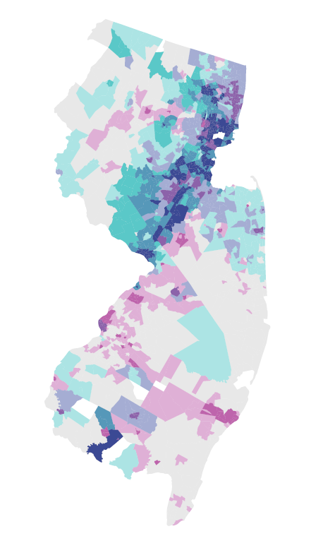
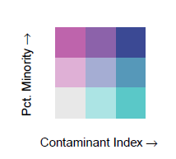


About me
Figure: Drinking Water Contaminant Index and % Minority in New Jersey

Slide 3
Part 1: The Coase Theorem

Slide 4
Refresher on Market Failures
Recall market failures discussed in Lecture 2.
Information asymmetries, market power, public goods/bads, and externalities are sources of market failures.
Public goods lead to market failure because there’s little incentive to provide or purchase a good that is nonexcludable and nonrival.
Externalities are when private actions have unintended consequences on individuals not part of the transaction.

Slide 5
Theories of Regulation
Two broad theories of why the government should or does intervene in the economy through regulations:
The public interest theory of regulation suggests that government intervenes in the economy to promote the public interest in the face of imperfect information, market power, or externalities.
The interest group theory of regulation suggests that specific industries or interest groups capture government functions for rent-seeking purposes.

Slide 6

Is There a Role for Intervention?
The Coase Theorem
According to the Coase Theorem, private bargaining will result in an efficient resolution of negative externalities if property rights are assigned and transaction costs are minimal, regardless of who has the property rights.
Example: A farmer and a rancher build a fence.
Conclusion: Costly government intervention, which often has unintended consequences, may not be necessary to solve the problems of externalities and public goods/bads.
Aside: The theorem does not speak to issues of equity.
Note: Created using open-source AI software DALL-E.
“A farmer and a rancher agree to build a fence cow corn”
Notes:
Note this example is a game theoretical negotiation, not a market.

Slide 7
The Question of Transaction Costs
Ronald Coase, The Problem of Social Cost (1960), pg. 16: “The argument has proceeded up to this point on the assumption… that there were no costs involved in carrying out market transactions. This is, of course, a very unrealistic assumption.” Transaction costs include:
Discovery costs.
Legal costs.
Collective bargaining costs.
Compliance/enforcement costs.
Time.
Coase: “These operations are often extremely costly, sufficiently costly at any rate to prevent many transactions that would be carried out in a world in which the pricing system worked without cost.”

Slide 8

A Real Example
The city of Santa Maria, California was located close to a cattle feedlot that produced noxious odors and other air emissions. As the town expanded closer and closer to the feedlot, residents began to complain more about the smells.
Two actors, multiple decisions:
The cattle feedlot controls the odors or ceases operation.
The town puts up with the odors or pays the polluter some amount to minimize the noxious smell.
Solution: The city council voted for a tax on all residents to pay the feedlot owner to move (Source: Kolstad, 2011).
Note: Created using open-source AI software DALL-E.

Slide 9

Limitations of the Coase Theorem:
Back to Pigou
Pigou’s original example of an externality in The Economics of Welfare (1920) is a train causing sparks that catch forests and farms on fire. This illustrates some hurdles to Coasian bargaining:
Difficult to establish causation (i.e., “assignment problems”).
The collective action problem (free-riding and bargaining within/across groups).
Imperfect information about payoff or damage functions.
Non-maximizing behavior.
Wealth effects and the endowment effect.
Note: Created using open-source AI software DALL-E.

Slide 10
In Defense of Coase
The Coase Theorem is like “economics in a vacuum.” While not directly applicable to most scenarios of interest, it provides some policy implications:
Because transaction costs are everywhere, the theorem is counter-intuitively a strong argument for government intervention in many cases.
Paying polluters to reduce emissions might be the most efficient outcome.
More generally, creative implementation of property rights over environmental goods is one method of mitigating environmental problems in a cost-effective way.

Slide 11
Part 2: Regulatory Instruments

Slide 12
Regulatory Instruments
Many regulatory instruments are available. These need not be implemented in isolation:
Information approaches
Toxic Releases Inventory and the Emergency Planning and Community Right-to-Know Act
Behavioral Nudges
Liability approaches
CERCLA and the Superfund program
Prescriptive Regulations (Command-and-Control)
Technology and performance-based standards
Emission Fees or Abatement Subsidies
Pigouvian taxes
Quantity Control and Allowance Trading
Cap-and-trade systems

Slide 13

Information Approaches: TRI
Information-based approaches help to solve market failures that may arise from information asymmetries. Examples: eco-labeling, environment/sustainability/governance metrics.
The Emergency Planning and Community Right to Know Act created the Toxic Releases Inventory (TRI) program in 1983.
TRI tracks some facilities that emit pollution into air, land, and water.
Hundreds of pollutants and their emission quantities by type of release are reported to the program each year.
Toxic Release Inventory and Superfund Sites in the US
Note: TRI sites in blue and Superfund sites in red.
Source: Persico, 2019.

Slide 14
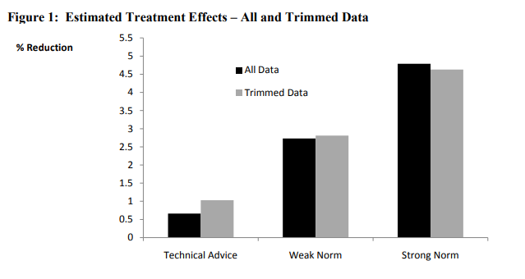
Information Approaches:
Behavioral Nudges
Providing consumers or firms with technical advice for improving their behavior or information about their activities in comparison to their peers can elicit conservation behaviors.
In one study, water ratepayers in Atlanta were randomly given:
Technical advice,
An appeal to reduce water consumption,
A comparison to water consumption among peers.
The social comparison effect (c) is roughly the same as the effect of increasing water prices 12 to 15 percent, or $5 per month for a median user.
Source: Ferraro and Price, 2011.

Slide 15
Information Approaches:
Behavioral Nudges
Providing consumers or firms with technical advice for improving their behavior or information about their activities in comparison to their peers can elicit conservation behaviors.
In one study, water ratepayers in Atlanta were randomly given:
Technical advice,
An appeal to reduce water consumption,
A comparison to water consumption among peers.
The social comparison effect (c) is roughly the same as the effect of increasing water prices 12 to 15 percent, or $5 per month for a median user.
Source: Ferraro and Price, 2011.

Slide 16
Regulatory Instruments
Many regulatory instruments are available. These need not be implemented in isolation:
Information approaches
Toxic Releases Inventory and the Emergency Planning and Community Right-to-Know Act
Behavioral Nudges
Liability approaches
CERCLA and the Superfund program
Prescriptive Regulations (Command-and-Control)
Technology and performance-based standards
Emission Fees or Abatement Subsidies
Pigouvian taxes
Quantity Control and Allowance Trading
Cap-and-trade systems

Slide 17
Liability approaches
Liability rules create incentives for acceptable behavior of firms and facilities by raising the costs of non-compliance or externalizing behavior. These are often used in conjunction with other regulatory instruments.

Slide 18
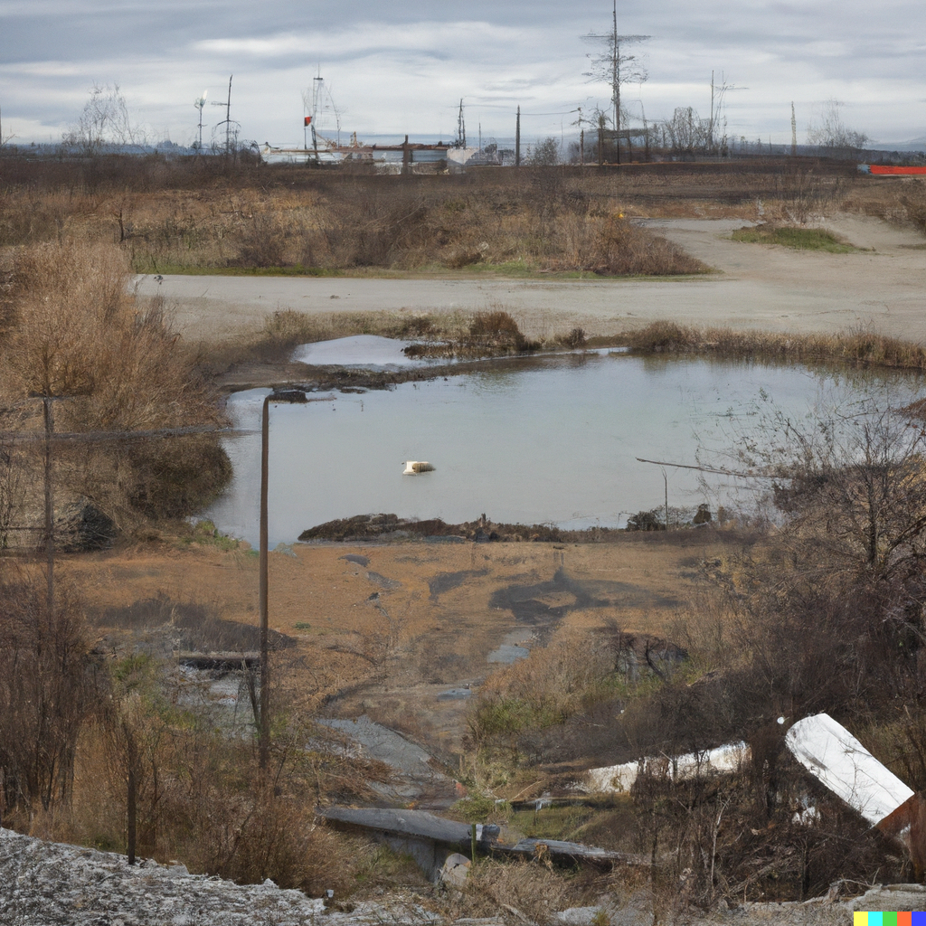
Liability approaches: Examples
Some common examples:
Legal institutions that compel payment for clean-up (i.e., the Superfund program).
Non-compliance fees for violating set environmental standards.
Deposit refunds (e.g., for recycling).
Note: Created with DALL-E (“superfund site”).

Slide 19
Regulatory Instruments
Many regulatory instruments are available. These need not be implemented in isolation:
Information approaches
Toxic Releases Inventory and the Emergency Planning and Community Right-to-Know Act
Behavioral Nudges
Liability approaches
CERCLA and the Superfund program
Prescriptive Regulations (Command-and-Control)
Technology and performance-based standards.
Emission Fees or Abatement Subsidies
Pigouvian taxes
Quantity Controls
Cap-and-trade systems

Slide 20
Prescriptive Regulations
Command-and-control, or prescriptive regulatory instruments, stipulate the outcome or action that a firm or facility must achieve to limit pollution or protect the environment. Firms often have some flexibility in meeting the requirements.
Two general types:
Technology-based standards: a firm must install a specific technology to comply with the regulation.
Performance-based standards: a firm must ensure that pollution emissions meet a designated target emission quantity or rate.

Slide 21
Prescriptive Regulations
Command-and-control, or prescriptive regulatory instruments, stipulate the outcome or action that a firm or facility must achieve to limit pollution or protect the environment. Firms often have some flexibility in meeting the requirements.
Two general types:
Technology-based standards: a firm must install a specific technology to comply with the regulation.
Performance-based standards: a firm must ensure that pollution emissions meet a designated target emission quantity or rate.

Slide 22
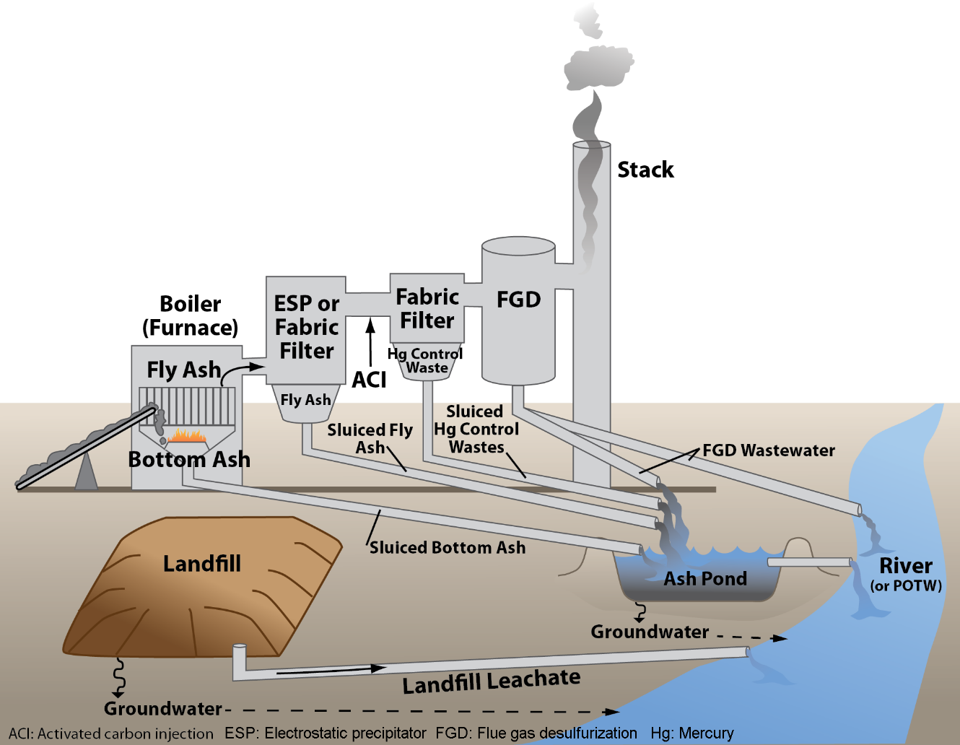
Prescriptive Regulations: Examples
Real-world examples:
Clean Water Act’s “best available technology economically achievable” for effluent limitation guidelines.
Occupational Safety and Health Administration (OSHA) permissible exposure limits (PELs) for chemicals exposure in the workplace.
Note: Key coal ash waste-streams.
Source: EPA Steam Electric Power Generating Effluent Guidelines.

Slide 23
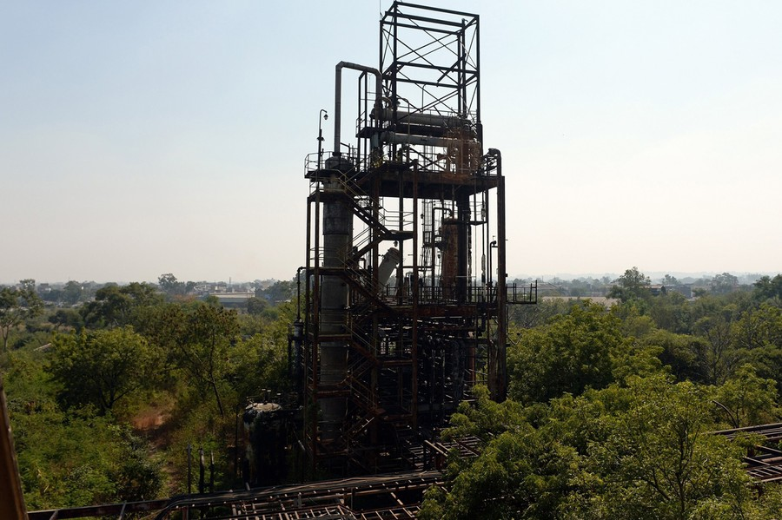

Prescriptive Regulations: Examples
Another real-world example:
The Risk Management Program requires risk management plans (RMPs) for facilities handling or storing risky substances.
Inspired by the Bhopal Union Carbide Chemical plant disastrous release of methyl isocyanate in 1984.
Source: Bhopal: The World's Worst Industrial Disaster, 30 Years Later, The Atlantic, 2014.

Slide 24
Regulatory Instruments
Many regulatory instruments are available. These need not be implemented in isolation:
Information approaches
Toxic Releases Inventory and the Emergency Planning and Community Right-to-Know Act
Behavioral Nudges
Liability approaches
CERCLA and the Superfund program
Prescriptive Regulations (Command-and-Control)
Technology and performance-based standards.
Emission Fees or Abatement Subsidies
Pigouvian taxes
Quantity Control and Allowance Trading
Cap-and-trade systems
Market-based instruments.

Slide 25
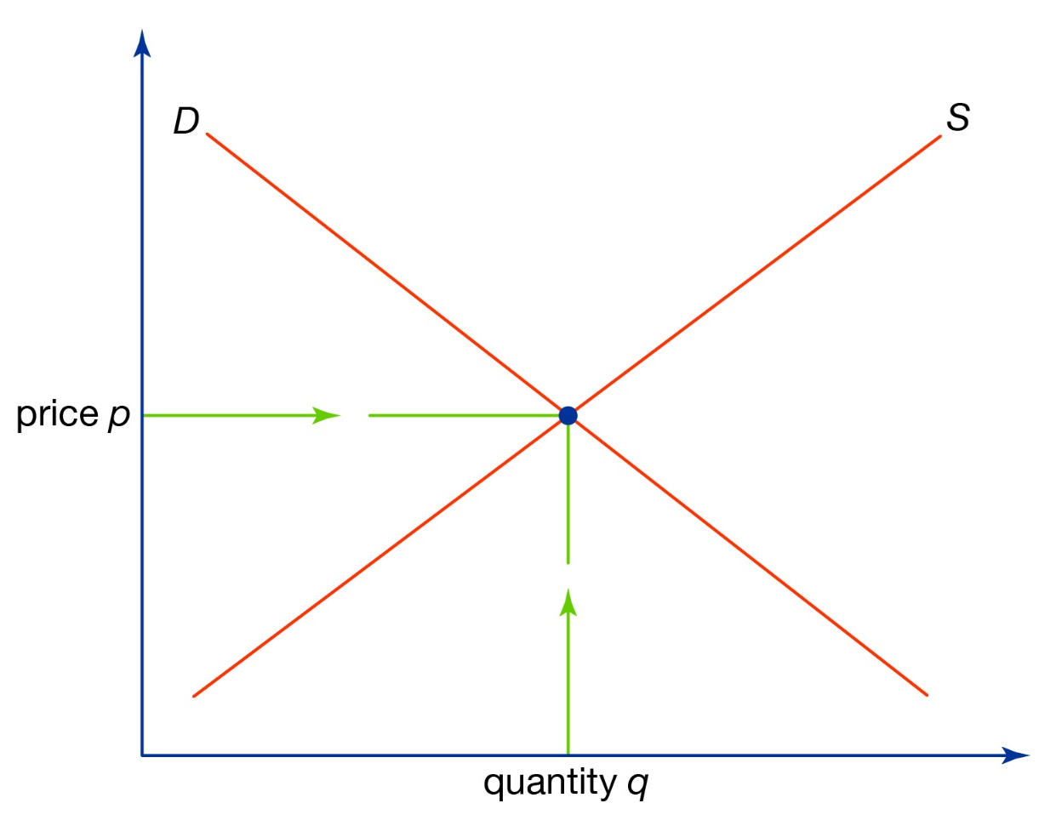

Emissions Taxes
Emissions taxes, a form of Pigouvian tax, charge the polluter for each unit of pollution they emit. Recall the discussion in lecture 2 regarding plastic bags.
What is the optimal tax?
Social
Marginal
Costs
Price
Private
Marginal
Costs
Private
Marginal
Benefit
External
Marginal
Costs
$$b_{p}^{∗}$$
# of Bags

Slide 26
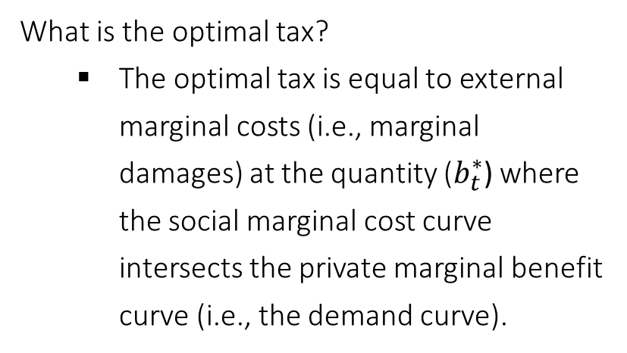
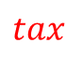

Emissions Taxes
What is the optimal tax?
The optimal tax is equal to external marginal costs (i.e., marginal damages) at the quantity ($b_{t}^{∗}$) where the social marginal cost curve intersects the private marginal benefit curve (i.e., the demand curve).
Social
Marginal
Costs
Price
Private
Marginal
Costs
Private
Marginal
Benefit
External
Marginal
Costs
$$tax$$
$$b_{p}^{∗}$$
$$b_{t}^{∗}$$
# of Bags

Slide 27
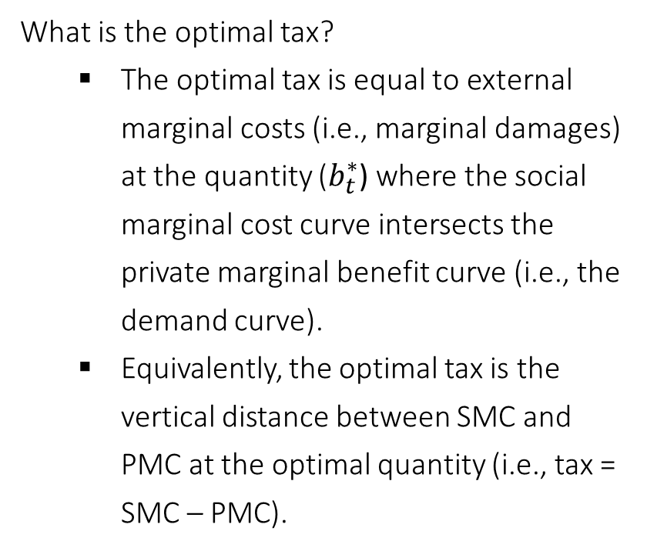
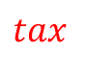
Emissions Taxes
What is the optimal tax?
The optimal tax is equal to external marginal costs (i.e., marginal damages) at the quantity ($b_{t}^{∗}$) where the social marginal cost curve intersects the private marginal benefit curve (i.e., the demand curve).
Equivalently, the optimal tax is the vertical distance between SMC and PMC at the optimal quantity (i.e., tax = SMC – PMC).
Social
Marginal
Costs
Price
Private
Marginal
Costs
$$tax$$
Private
Marginal
Benefit
External
Marginal
Costs
$$tax$$
$$b_{p}^{∗}$$
$$b_{t}^{∗}$$
# of Bags

Slide 28

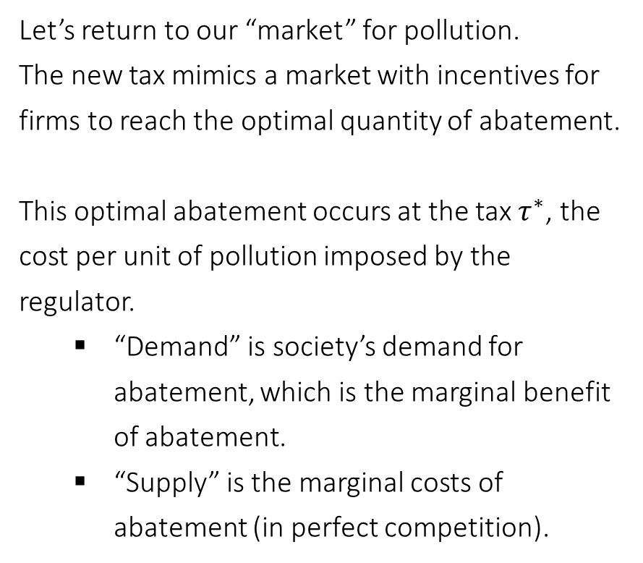
“Market” for Pollution
Let’s return to our “market” for pollution.
The new tax mimics a market with incentives for firms to reach the optimal quantity of abatement.
This optimal abatement occurs at the tax $τ^{∗}$, the cost per unit of pollution imposed by the regulator.
“Demand” is society’s demand for abatement, which is the marginal benefit of abatement.
“Supply” is the marginal costs of abatement (in perfect competition).
Cost of
Abatement
Marginal
Costs of
Abatement
$τ^{∗}$
Marginal
Benefit of
Abatement
Units of pollution abatement

Slide 29
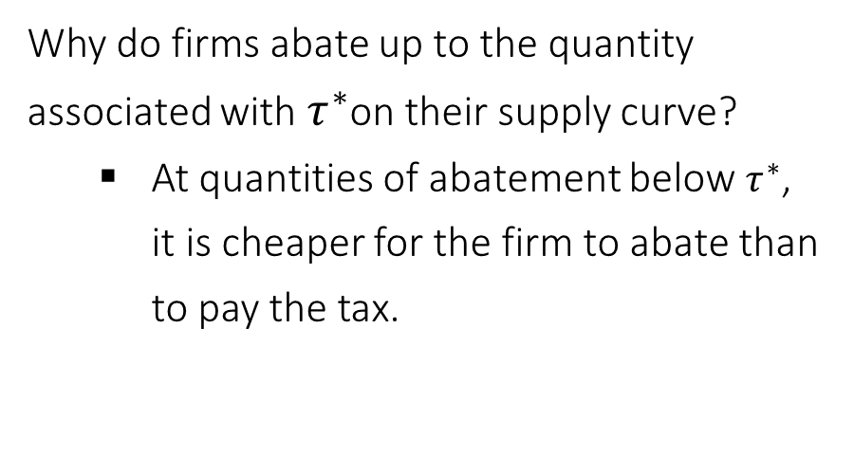
“Market” for Pollution
Why do firms abate up to the quantity associated with $τ^{∗}$on their supply curve?
At quantities of abatement below $τ^{∗}$, it is cheaper for the firm to abate than to pay the tax.
Marginal Benefits and Marginal Costs
Cost of
Abatement
Marginal
Costs of
Abatement
$τ^{∗}$
Not profit maximizing
Marginal
Benefit of
Abatement
Units of pollution abatement

Slide 30
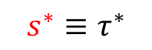
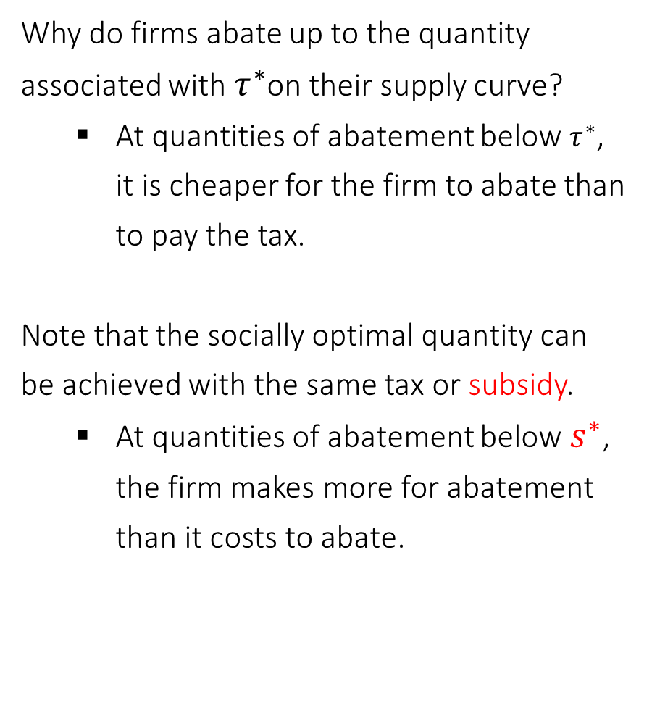
Abatement Subsidies
Why do firms abate up to the quantity associated with $τ^{∗}$on their supply curve?
At quantities of abatement below $τ^{∗}$, it is cheaper for the firm to abate than to pay the tax.
Note that the socially optimal quantity can be achieved with the same tax or subsidy.
At quantities of abatement below${ s}^{∗}$, the firm makes more for abatement than it costs to abate.
Marginal Benefits and Marginal Costs
Cost of
Abatement
Marginal
Costs of
Abatement
${s^{∗}≡τ}^{∗}$
Not profit maximizing
Marginal
Benefit of
Abatement
Units of pollution abatement

Slide 31
Regulatory Instruments
Many regulatory instruments are available. These need not be implemented in isolation:
Information approaches
Toxic Releases Inventory and the Emergency Planning and Community Right-to-Know Act
Behavioral Nudges
Liability approaches
CERCLA and the Superfund program
Prescriptive Regulations (Command-and-Control)
Technology and performance-based standards.
Emission Fees or Abatement Subsidies
Pigouvian taxes
Quantity Control and Allowance Trading
Cap-and-trade systems
We’ll pick up with quantity controls next time.

Slide 32
Next class
If you have questions about the first midterm, please e-mail Bryan, Katie, and Yagmur.
We will be playing a pollution trading game to illustrate cap-and-trade next class. It is a modified version of musical chairs. Please let me know if you have any concerns about your willingness or ability to participate.
Assigned materials for next Monday:
K&O (textbook) Chapter 9
Building a Carbon Trading System in New York (RFF Podcast)

